Slide 1
TEACHER CUE
CFU
HINT
Scaffolding for students
MAKE THE CONNECTION
Allow students to make the connection

Slide 2
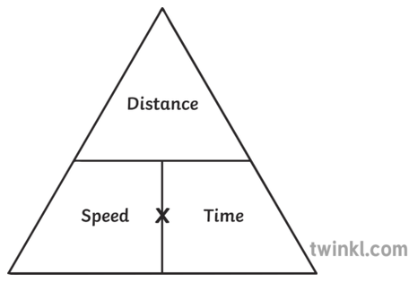
What distance does a aeroplane travel flying at 500 km/hr for 10 hours

Slide 3
4) A mouse can run at 10 km/hr. How far can it run in 0.5 hour?

Slide 4
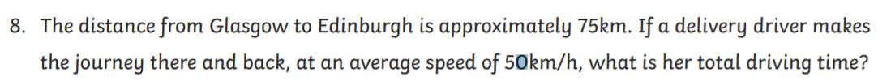
7)

Slide 5
We will be able to calculate and describe acceleration of a moving object
TRACK WITH ME
READ WITH ME
^{I can define acceleration}
I can calculate average acceleration

Slide 6
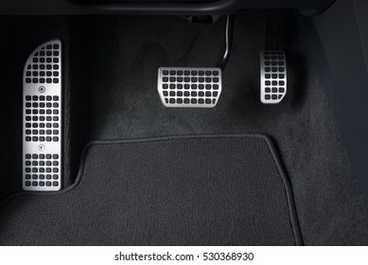
The accelerator of a car is given that name because pushing down on it usually makes the car accelerate.

Slide 7
Acceleration
When an object is moving in a straight line the acceleration is a measure of the rate at which it changes speed.
Average acceleration = change in speed
time taken
a = v(end) – v(start)
time taken

Slide 8
Example
A car travelling at 60 km/hr that increases its speed to 100 km/hr in 5.0 seconds has an average acceleration of:
Average acceleration = change in speed
time taken
= (100 km/hr – 60km/hr)
5.0 s
= 8.0 km per second

Slide 9
If the change in speed is an increase then the acceleration is positive.
If the change in speed is a decrease then the acceleration is negative.

Slide 10
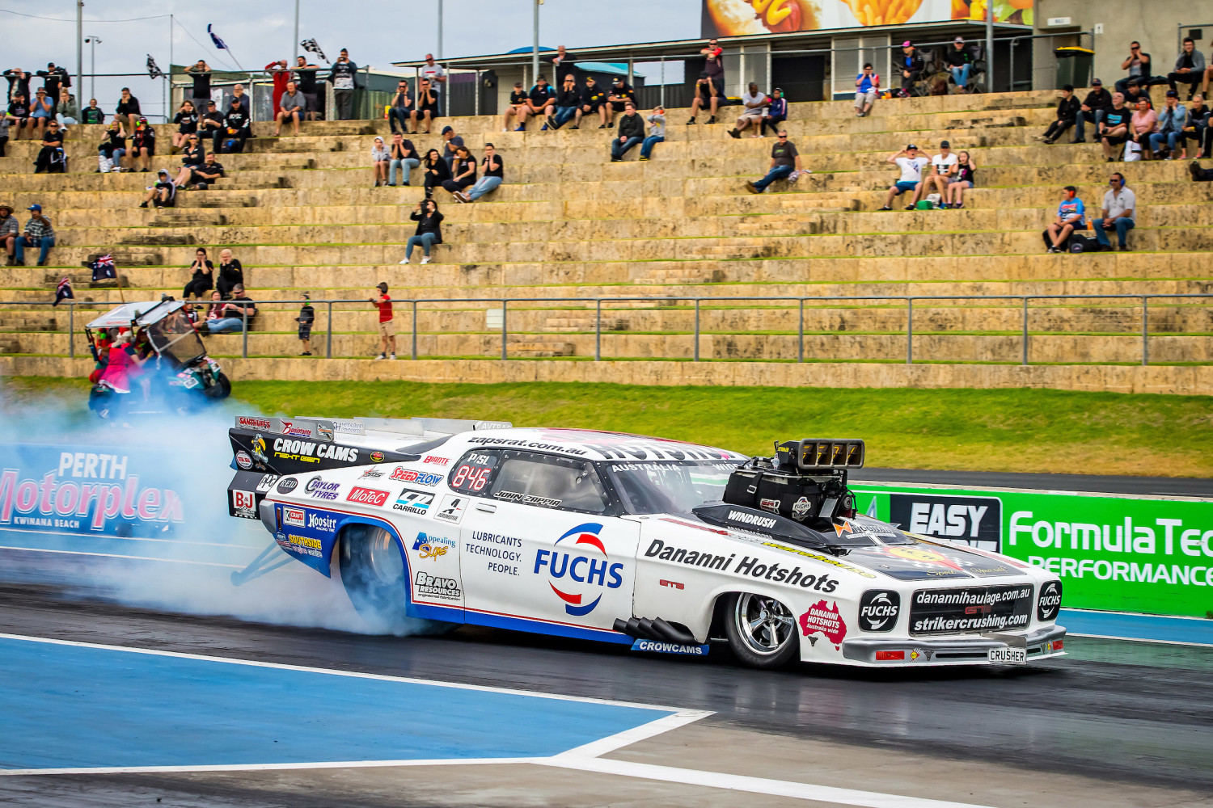
Drag racing
In drag racing, from a standing start cars need to cover a distance of 400 metres in the fastest possible time. This means they need to reach very high speeds very quickly.
The fastest drag racing cars can reach speed of more than 500km/hr in less than 5.0 seconds

Slide 11
Drag racing
The average acceleration of a drag car that reaches a speed of 506 km/hr in 4.6 seconds is
Average acceleration = change in speed
time taken
= 506 km/hr
4.6 s
= 110 km/hr per second

Slide 12
Explain the difference between acceleration and deceleration

Slide 13
3, A car has stopped at a set of traffic lights sets off when the light turns green. It increases its speed by 5 m/s during each of the first 3 s after it starts off, and by 3 ,/s during the following 2 s.
What is the speed after
1 sec
2 sec
5 sec
b) What is the average acceleration of the car during the first 5 s after it sets off

